Slide 1

Branches & GIT
Where to put what you do, and how.

Slide 2
Agenda
Releases
Branches
GIT

Slide 3
Releases
Types.
Public
Community edition
Enterprise edition
Telco edition
Private
Custom release for customers (one per customer!)

Slide 4
Releases
Public Releases
There are three types of public releases:
Maintenance
Minor
There are only bug fixes in this releases.
No new features.
Easy adoption for existing customers: no risk of a new feature breaking something.
Only the last digit changes. Example. 3.0.1, 3.0.2, 3.0.3.
Major
There are new features and bug fixes in this releases.
The new features do not represent a huge change.
Only the middle digit changes. Example. 3.1.0, 3.4.0, 2.5.0 (note that the last digit is always a zero)
Something big changed
From jBilling 1 to 2: switch from JBoss – EJB to Tomcat - Spring
From jBilling 2 to 3: new GUI and adoption of Grails for UI layer
Only the first digit changes. Example. 1.0.0, 2.0.0, 3.0.0 (note that the last two digits are always zero)

Slide 5
Releases
Public Releases - CE & EE
The community is simply a parallel release with some missing features
Pricing Models
Plans
Security
When EE releases, CE releases as well: major, minor, maintenance

Slide 6
Agenda
Releases
Branches
GIT

Slide 7
Branches
The main jBilling repository is often call ‘enterprise’.
It has many branches to facilitate releases.
It also has temporary branches for specific new features.

Slide 8
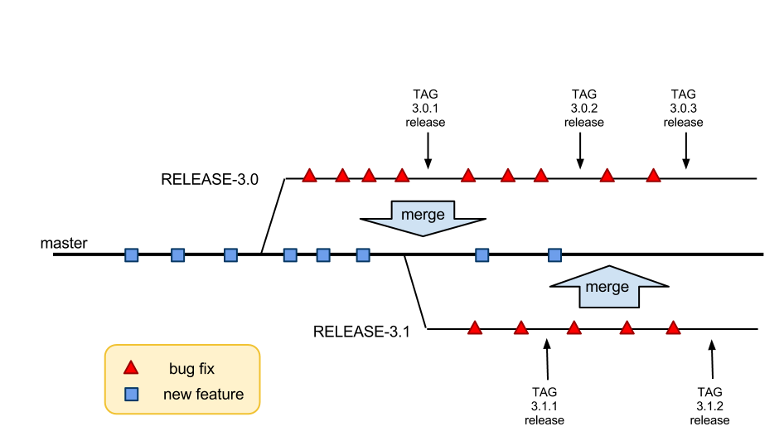
Branches
Master and release branches

Slide 9
Branches
enterprise/master
enterprise/telco
Takes new features.
The goal is a new minor release.
Release branches are often merged into It to pick up bug fixes.
enterprise/RELEASE-XXXXX-Y.Y
This branch is specific for Telecom Companies.
It has features and changes that are required or usually used in those businesses.
Sometimes are new features or sometimes UI changes.
enterprise/demo
Starts from ‘master’ when a new release is done.
Then it takes only bug fixes.
There are several of them, one per minor release.
They are tagged every time a release is done.
This branch is used by clients to test jBilling.
It was created from enterprise/RELEASE-enterprise-3.2
There’s a step-by-step tutorial document with some basic things to do in jBilling.
It has sample data.

Slide 10
Branches
Private releases
We always start a new project with a new repository.
The repository is hosted in GitHub.
The repository is started from a release branch: use the latest stable code.
The repository starts from the Enterprise Edition.
It is common to only have a master branch.

Slide 11
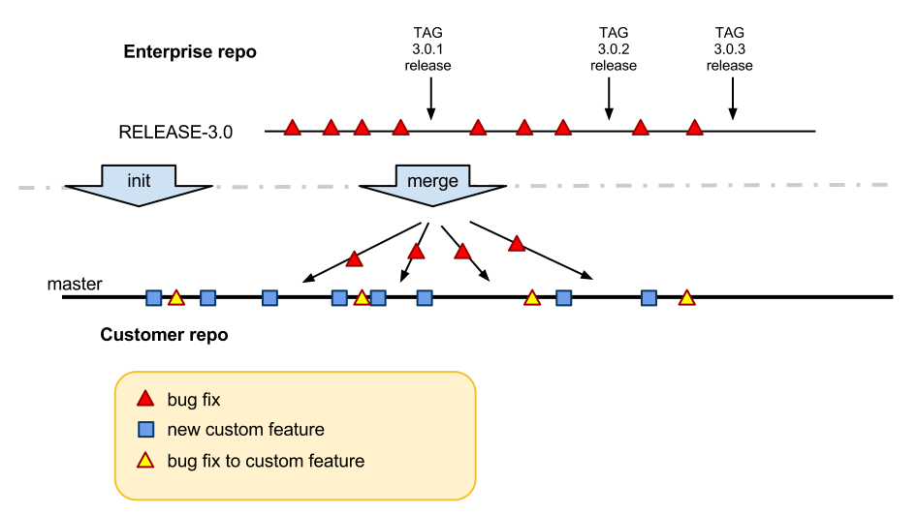
Branches
Private releases & EE

Slide 12
Agenda
Releases
Branches
GIT

Slide 13
GIT
Intro
We use GIT for all the code versioning
GIT is tough to learn, but then it is really helpful.
The actual repositories are in GitHub

Slide 14
GIT
GitHub
GitHub is great and easy to use for:
Quickly review some file.
Review the history of a file.
Find a list of commits.
Find out who did some changes.
Use an avatar!

Slide 15
GIT
Some global settings first…
Make sure you GIT configuration has been set for the following variables:
git config --global user.name “Juan Vidal"
git config --global user.email juanv@jbilling.com
git config --global core.autocrlf=false
git config --global --add color.ui true
Use your jBilling email id in the email attribute. This will ensure that you get all the messages from jBilling build admin.

Slide 16
GIT
We need GIT to…
Review the history of a file.
See what is different between two commits.
Merge.
Cherry pick.
Find out who did some changes.

Slide 17
GIT
Commands
clone
remote-add
fetch
checkout
branch
add
commit
push

Slide 18
GIT
Commands
clone
This command is used to clone a GIT repository to your local computer.
This is usually the first thing you do when working in jBilling whether if it is for a client or the jBilling project itself. You need to have the code locally.
Example
git clone git@github.com:emilc/enterprise.git enterprise

Slide 19
GIT
Commands
remote-add
This command is used to add a remote repository different than the one you are running the command in.
It’s something that happens locally in your computer, it doesn’t affect the origin. Unless you do a push of course!
This can be used for example to remotely add the jBilling repository into a client’s repository to do a merge of the latest bug fixes and features.
Example
git remote add NorthPower git@github.com:emilc/NorthPower.git

Slide 20
GIT
Commands
fetch
This command is used to fetch all the content of a remote repository to your local computer.
This would be the next step after using the remote-add command.
Example
git fetch NorthPower

Slide 21
GIT
Commands
checkout
This command is used to create a branch from a remote repository.
Or to switch to an existing local branch.
This will be the last step after you have executed the remote-add and the fetch commands.
Example
git checkout -b NorthPower NorthPower/master
git checkout RELEASE-enterprise-3.1

Slide 22
GIT
Commands
branch
This command is used to create a new branch locally.
You would use this for example if you have to develop a new feature. For that scenario we usually create a new branch and after the development is complete it has been reviewed it’s eventually merged into the release branch.
You can also get a list of local and remote branches.
Example
git branch newFeature
git branch –l
git branch –r
git branch -a

Slide 23
GIT
Commands
add
This command is used to track new files or to stage changes to existing ones. This is the way to tell GIT what is going to be pushed and what’s not.
Example
git add path-to-file

Slide 24
GIT
Commands
commit
Like the name suggests this command is used to commit a bunch of changes.
This happens locally, nothing is sent to the actual repository.
Example
git commit –m “<redmine issue number> - <redmine title>”
git commit –am “<redmine issue number> - <redmine title>”

Slide 25
GIT
Commands
push - Checks To Do Before Pushing Code
Enterprise release or master branches
As a checklist or rule, always ensure the following:
RUN grails prepare-test.
Execute WS test cases using: ant test .
Make sure the test pass or fix if needed.
Client Branches:
Initialize DB with data.sql or the -client parameter for Liquibase.
Execute WS test cases using: ant -f client-specific-build.xml.
Make sure the test pass or fix if needed.
And then push.

Slide 26
GIT
Commands
push
This command actually pushes the changes that were committed locally to the repository.
Example
git push NorthPower NorthPower:master
git push <local_repository> <refspec>

Slide 27
GIT
More commands
log
diff
merge
cherry-pick
stash

Slide 28
GIT
Commands
log
To see a chronological list of the parents (commits) of any branch, you can run it when you are in that branch.
Example
git log
git log --oneline --graph

Slide 29
GIT
Commands
diff
This command lets you see the difference between two commits or of a modified file.
Example
git diff path-to-file
git diff commit1-hash..commit2-hash -- path-to-file

Slide 30
GIT
Commands - Moving code across branches
‘merge’ and ‘cherry-pick’ are used to get code from one branch to another.
There are fundamental differences between them!
merge
cherry-pick
Merge preserves the order and time of each commit.
Merge makes the receiving branch compatible with the source branch.
Once you merge it is easy to merge later on.
cherry-pick will copy a commit from one branch to another. It is a new commit.
The new commit is just that, it has no “connection” to the original commit.
Things like date or author are not copied, only the code changes.

Slide 31
GIT
Commands
merge - When to use it?
Taking bug fixes from a release branch to the master branch.
Taking bug fixes from a release branch to a customer repository.
You need to regularly merge the release branch with the customer repository! Even when the customer repository has many customizations.
The branches have to be made compatible.
This is critical, otherwise the bug fixes need to be redone all the time!
Example
git merge <origin-branch>

Slide 32
GIT
Commands
cherry-pick - When to use it?
Bring a new feature from enterprise to a customer repo, or vice versa.
Bring a bug fix or other change between to incompatible branches
Otherwise, use ‘merge’

Slide 33
GIT
Commands
stash
Often, when you’ve been working on part of your project, things are in a messy state and you want to switch branches for a bit to work on something else. The problem is, you don’t want to do a commit of half-done work just so you can get back to this point later.
This command is the answer to this issue:
Stashing takes the dirty state of your working directory that is, your modified tracked files and staged changes and saves it on a stack of unfinished changes that you can reapply at any time.
Example
git stash list
git stash [save “message”]
git stash clear
git stash pop|apply

Slide 35
!Thank you!

